Slide 1
Project Time Management
Project Time Management includes the processes which are required to manage timely completion of the project
The processes interact with each other and with processes in the other knowledge areas. Each process occurs at least once in every project
The project time management processes and their associated tools & techniques are documented in the schedule management plan. The schedule management plan is a subsidiary plan of the project management plan, and may be highly detailed or broadly framed based on the needs of the project

Slide 2
Project Time Management
Define Activities
Sequence Activities
Estimate Activity Resources
Estimate Activity Durations
Develop Schedule
Control Schedule

Slide 3
Activity Definition
It is the process of identifying the specific actions to be performed to produce the project deliverables
Project work packages are created at the lowest level in WBS which are further decomposed in to smaller components called activities that represent the work necessary to complete the work package
Activities provide a basis for estimating, scheduling, executing, and monitoring & controlling the project work

Slide 4
Activity Definition
The outputs of Activity Definition include:
  Activity List
    It includes a comprehensive list including all schedule activities required on the project. The activity list includes the Activity Identifier and a scope of work description for each activity
  Activity Attributes
    It extends the description of the activity by identifying the multiple components associated with each activity. During the initial stages they include the Activity ID, WBS ID, and Activity Name and on completion it may include activity codes, activity description, predecessor activities, successor activities, leads & lags, resource requirements, imposed dates, constraints, and assumptions.

Slide 5
Activity Definition
  Activity Attributes
    Activity attributes are used for schedule development and for selecting, ordering, and sorting the planned schedule activities in various ways within reports.
  Milestone List
    A milestone is a significant point or event in a project. A milestone list identifies all milestones and indicates whether the milestone is mandatory, such as those required by contract for purpose of payment.

Slide 6
Techniques & Terminology for Scheduling
The technique used for project scheduling will vary depending upon size, complexity, duration, personnel, and owner requirements. There are two general methods that are commonly used:
  Gantt chart (bar chart) – It is a graphical time scale of the schedule without showing any interdependencies and does not integrate cost or resources with the schedule.
  Network Analysis System (NAS)
    Critical Path Method (CPM) – also called network analysis system is most commonly used in the engineering and construction industry. CPM eliminates the restrictions imposed by bar chart method. It uses a deterministic approach.
    Program Evaluation and Review Technique (PERT) – also referred to as network analysis system, is used for scheduling projects with very high degree of uncertainty.
Notes:
A network is a logical and chronological graphic representation of the activities (and
events) composing a project. Network diagrams are basically of two types: arrow
networks and node networks.

Slide 7
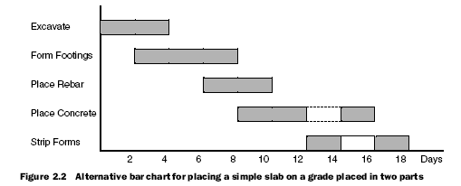
Techniques & Terminology for Scheduling
Example of a Bar Chart Diagram

Slide 8
Techniques & Terminology for Scheduling
Project schedules can be drawn graphically in form of networks using the CPM methodology either as activity on arrow (AOA or arrow diagram) diagrams or activity on node (AON or Precedence Diagram) diagrams.
PDM includes four types of dependencies or logical relationships:
  Finish-to-start (FS). The initiation of the successor activity depends upon the completion of the predecessor activity.
  Finish-to-finish (FF). The completion of the successor activity depends upon the completion of the predecessor activity.
  Start-to-start (SS). The initiation of the successor activity depends upon the initiation of the predecessor activity.
  Start-to-finish (SF). The completion of the successor activity depends upon the initiation of the predecessor activity.

Slide 9
Techniques & Terminology for Scheduling
Every activity and milestone except the first and last are connected to at least one predecessor and one successor activity.
A predecessor activity is the one that comes earlier in a logical relationship between two or more activities.
A successor activity is the one that comes later in a logical relationship between two or more activities.

Slide 10
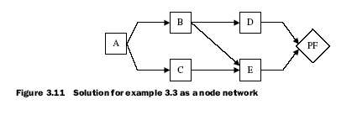
Techniques & Terminology for Scheduling
AON Diagram
An activity represented in the form of a box. It is called a “NODE”.
This link from Activity A to C is the relationship defining the execution logic of the connected activities. It can be a SS, SF, FS or FF relationship.
For Activity E, Activity B & C are the predecessor activities and activity/milestone PF is the Successor.

Slide 11
Activity Sequencing
It is the process of identifying and documenting relationships among the project activities.
Activities are sequenced using logical relationships. For CPM method these include SS, SF, FS & FF relationships as described earlier.
Sequencing can be performed by using project management software or by using manual or automated techniques

Slide 12
Activity Sequencing (Tools & Techniques)
PDM is a method used in Critical Path Methodology (CPM) for constructing a project schedule network diagram that uses boxes or rectangles, referred to as nodes, to represent activities, and connects them with arrows that show the logical relationships that exist between them.
PDM includes four types of dependencies or logical relationships:
  Finish-to-start (FS). The initiation of the successor activity depends upon the completion of the predecessor activity.
  Finish-to-finish (FF). The completion of the successor activity depends upon the completion of the predecessor activity.
  Start-to-start (SS). The initiation of the successor activity depends upon the initiation of the predecessor activity.
  Start-to-finish (SF). The completion of the successor activity depends upon the initiation of the predecessor activity.

Slide 13
Activity Sequencing
The outcomes of Activity Sequencing include:
  Project Schedule Network Diagrams:
    They are schematic displays of the project’s schedule activities and the logical relationships among them, also referred to as dependencies. A project schedule network diagram can be produced manually or by using project management software. It can include full project details or consist of one or more summary activities
  Project Document updates
    It includes:
      Activity lists
      Activity attributes
      Risk register

Slide 14
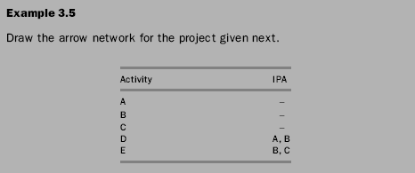
Activity Sequencing
Practice Example:
IPA – Immediately Preceding Activity

Slide 15
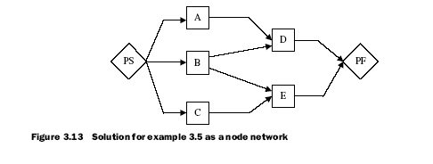
Activity Sequencing
Solution

Slide 16
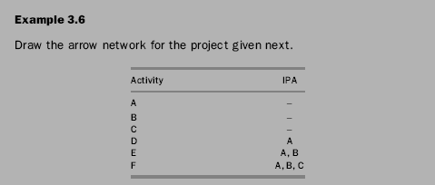
Activity Sequencing
Practice Example:

Slide 17
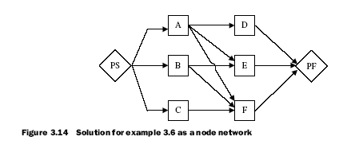
Activity Sequencing
Solution

Slide 18
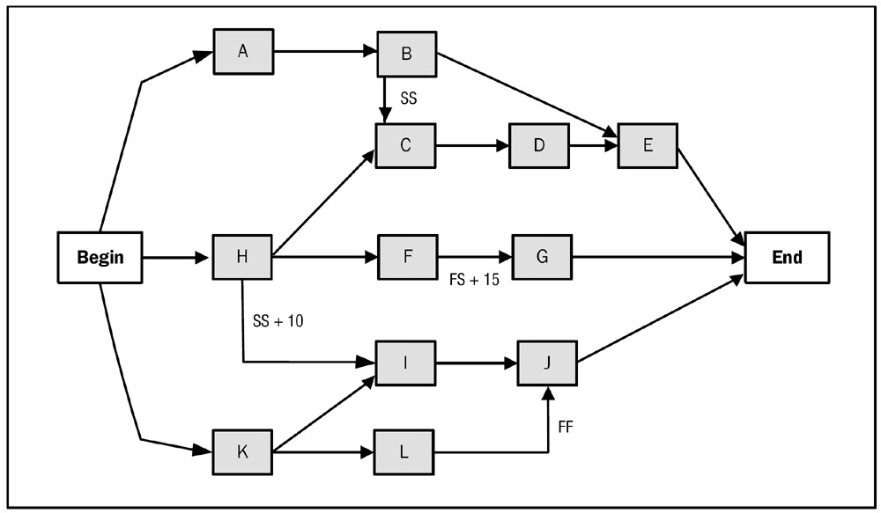
Activity Sequencing

Slide 19
Estimate Activity Resources
It is the process of estimating the type and the quantities of material, people, equipment or supplies required to perform each activity.
For example: In order to lay 200 ft3 of concrete in a mat foundation, we will need to determine the availability and exact quantities of each material required (sand, aggregates, cement, water, reinforcement, formwork), the availability and size of the labor crew and their mix that we intend to commit to this activity, availability and capacity of any special equipment required such as concrete batching and mixing plant, transit mixer trucks, concrete pumps, vibrating equipment, and other small tools.

Slide 20
Estimate Activity Resources
Resource Calendars:
Resource calendars specify when and how long identified project resources (such as people, equipment, and material) will be available during the project. This serves as an important input in estimating the duration of project activities and the project itself.
This information may be at the activity or project level. This knowledge includes consideration of attributes such as resource experience and/or skill level, as well as various geographical locations from which the resources originate and when they may be available.

Slide 21
Activity Duration Estimating
It is the process of approximating the number of work periods needed to complete individual activities with estimated resources.
The duration estimate is progressively elaborated e.g. as the project engineering and design work evolves, more detailed and precise data is available and the accuracy of duration estimates improves.
The activity duration estimating process requires that the amount of work effort required to complete the activity is estimated and the amount of resources to be applied to complete the activity is estimated (this is done in resource estimation process); these are then used to approximate the number of work periods (activity duration) needed to complete the activity

Slide 22
Activity Duration Estimating
The assignment of the duration that is required to accomplish an activity will vary depending on many factors: quantity and quality of work, number of people and/or equipment that is assigned to the activity, level of worker skills, availability of equipment, work environment, effectiveness of supervision of the work, and other conditions. Although these variations exist, a special effort must be made to determine a realistic duration for each activity because the duration that is assigned to activities in a CPM network diagram has a large impact on the schedule and overall management of a project.

Slide 23
Activity Duration Estimating
Many activities in a project are routine in nature, which enables a reasonably accurate determination of the probable time of completion. For these types of activities the duration can be determined by dividing the total quantity of work by the production rate, which is a function of the number of individuals that are assigned to the activity. A common mistake that is made by many people is to calculate the time to accomplish an activity assuming a continuous flow of uninterrupted work. However, all work is subject to delays, interruptions, or other events that can impact time. Thus, a reasonable amount of time (allowance) must be added to the calculated time to determine a realistic duration for each activity.

Slide 24
Activity Duration Estimating
Generally. the duration of an activity can be determined by one of three methods; by analyzing historical records from previously completed projects, by referencing commercially available manuals (RS Means – Reeds Construction Cost Data) that provide costs and production rates for various types of work or from the experience and judgment of the person who will be performing the work.
Another method called the three point estimate is also used to determine activity duration when it involves a significant amount of uncertainty.

Slide 25
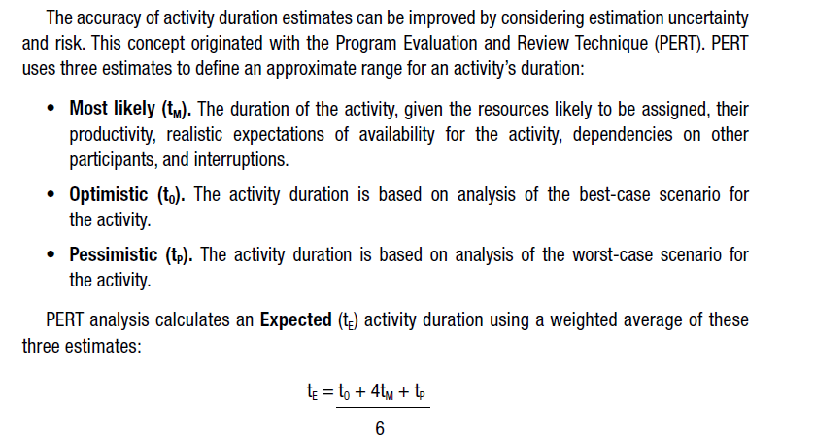
Activity Duration Estimating
Three point estimates

Slide 26
Activity Duration Estimating
The outputs include:
  Activity Duration Estimates
    These are quantitative estimates of the likely number of work periods that will be required to complete an activity
  Project Document updates
    Documents that may be updated include
      Activity attributes

Slide 27
Schedule Development
It is the process of analyzing activity sequences, durations, resource requirements, and schedule constraints to create the project schedule
Entering the activities, durations, and resources in to the scheduling tool generates a schedule with planned dates for completing project activities
Developing an acceptable project schedule is often an iterative process. It determines the planned start and finish dates for project activities and milestones

Slide 28
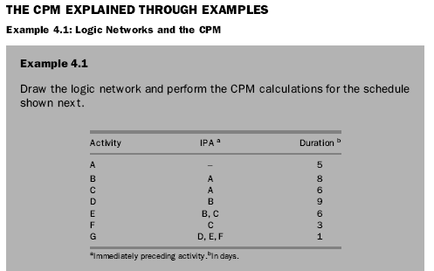
Schedule Development

Slide 29
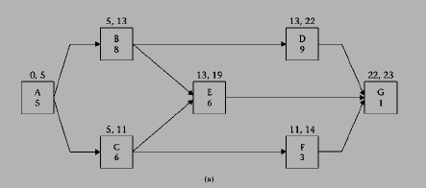
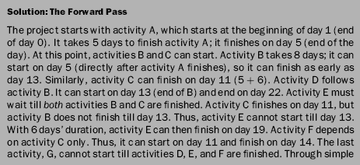


Slide 30
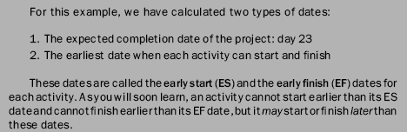
Schedule Development

Slide 31
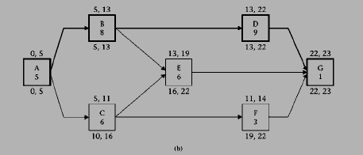
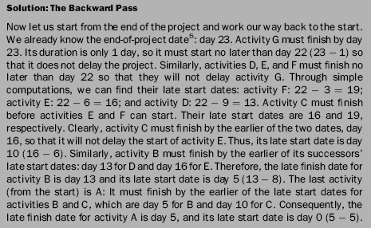

Slide 32
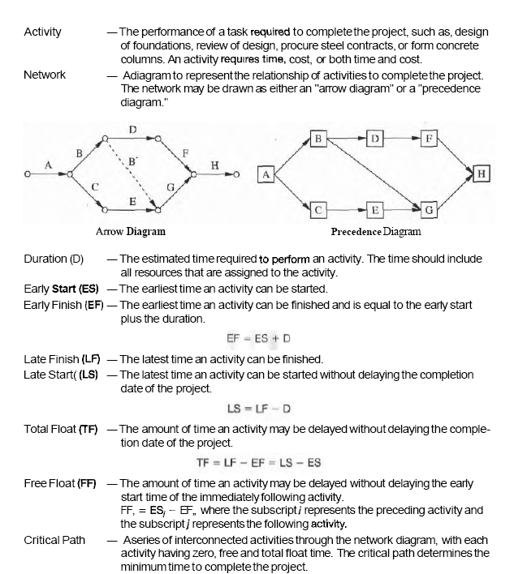
Notes:
Refer to Project Management for Engineering & Construction By Garold D. Oberlender – Ch:5 (Project Scheduling) Page:69-73

Slide 33
Scheduling Terminology
Backward pass: The process of navigating through a network from end to start and calculating the late dates for each activity. The late dates (along with the early dates) determine the critical activities, the critical path, and the amount of float each activity has.
Critical activity: An activity on the critical path. Any delay in the start or finish of a critical activity will result in a delay in the entire project.
Critical path: The longest path in a network, from start to finish, including lags and constraints.
Driving Relationship: A relationship from a predecessor activity that controls the start or finish of a successor activity. For any activity with predecessors, there must be at least one driving relationship.

Slide 34
Scheduling Terminology
Event: A point in time marking a start or an end of an activity. In contrast to an activity, an event does not consume time or resources. In computer software, events with significance can be created as milestones, and they are either start milestones, such as Notice to Proceed, or finish milestones, such as Substantial Completion.
Forward pass: The process of navigating through a network from start to end and calculating the completion date for the project and the early dates for each activity.
Lead Time: It is the number of work periods (Days) by which a successor activity can start before the finish date of predecessor activity in a finish to start relationship.
Lag Time: It is the number of work periods (Days) by which a successor activity can start after the finish date of predecessor activity in a finish to start relationship.

Slide 35
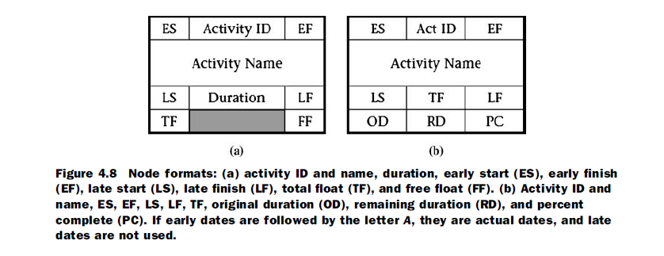
Node Formats
TF
ES,EF)
FF
Act ID/Name
Duration
A simple format. One that we will use in our networks.
(LS,LF)

Slide 36
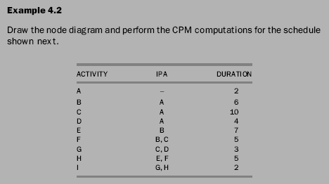
Schedule Development

Slide 37
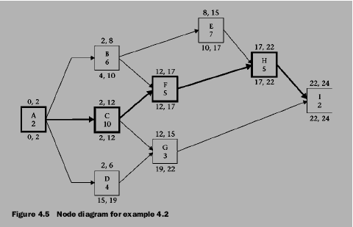
Schedule Development

Slide 38
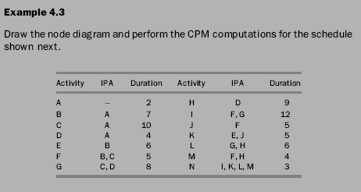
Schedule Development

Slide 39
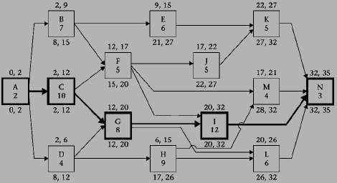
Schedule Development

Slide 40
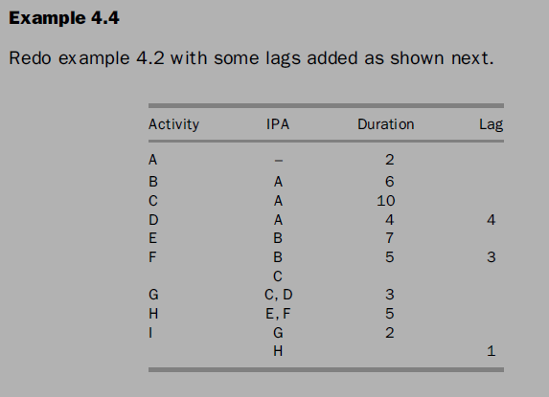
Schedule Development

Slide 41
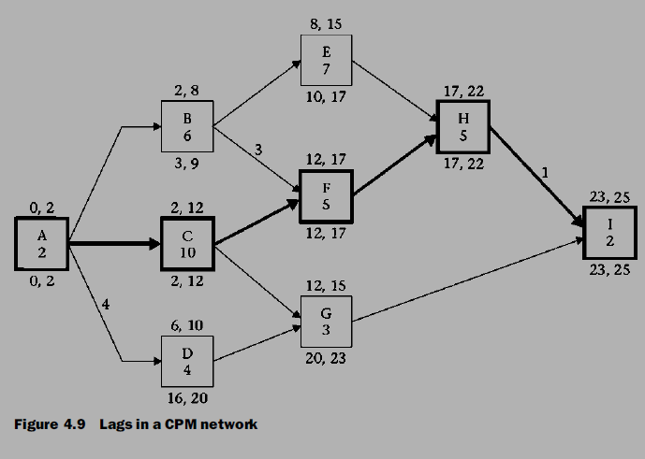
Schedule Development
Notes:
For more information please consult “Construction Project Scheduling & Control, 2nd Edition” Chapter 4 – The Critical Path Method

Slide 42
Schedule Development
Network Analysis using PERT.
Please follow attached PDF file named “PERT.pdf”
Notes:
Refer to Construction Project Scheduling & Control By SALEH MUBARAK– Ch:11 (Other Scheduling Techniques)

Slide 43
Schedule Development
Some of the outcomes include:
  Project Schedule
    The project schedule includes a planned start date and a planned finish date for each activity. The project schedule is presented in summary form or presented in detail
  Milestone charts
    They are similar to bar charts, but only identify the scheduled start or completion of major deliverables

Slide 44
Schedule Development
  Bar charts
    These charts, with bars represent activities, show activity start and end dates
  Project schedule network diagrams
    These diagrams with activity date information, usually show both the project network logic and the project’s critical path schedule activities
  Schedule Baseline
    A schedule baseline is a specific version of the project schedule developed from the schedule network analysis. It is accepted and approved by the project management team as the schedule baseline with baseline start dates and baseline finish dates. The schedule baseline is a component of the project management plan.

Slide 45
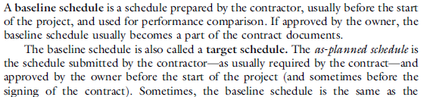
Schedule Development
Schedule Baseline
    It is a specific version of the project schedule developed from the schedule network analysis. It is accepted and approved by the project management team as the schedule baseline with baseline start dates and baseline finish dates. The schedule baseline is a component of the project management plan.

Slide 46
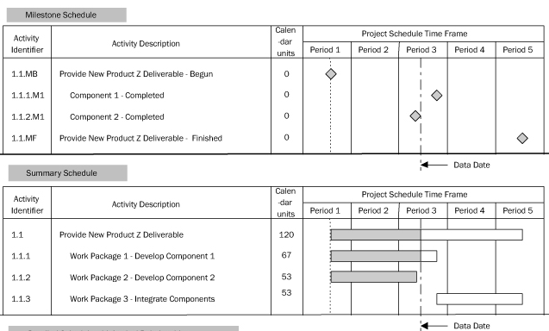

Slide 47
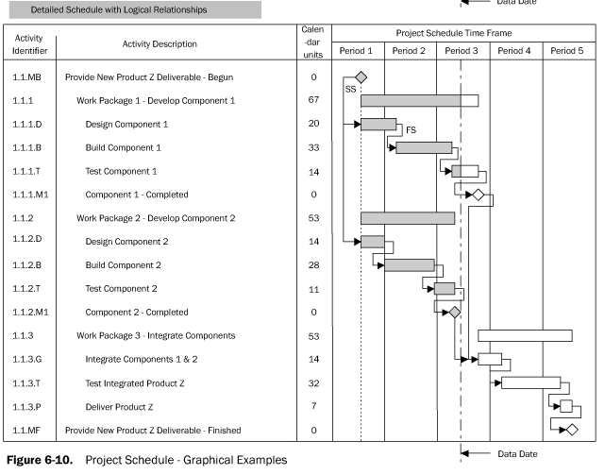

Slide 48
Schedule Control
It is the process of monitoring the status of the project to update project progress and manage changes to the schedule baseline
It is concerned with:
  Determining the current status of the project schedule (Work performance information - Information about project progress, such as which activities have started, their progress, and which activities have finished.
  Influencing the factors that create schedule changes
  Determining that the project schedule has changed, and (Comparing it with the baseline to determine deviations – where and how much)
  Managing the actual changes as they occur (taking corrective action to bring the project back on schedule)

Slide 49
Schedule Control
Some of the outcomes include:
  Change Requests
  Project Management Plan updates
  Project Document updates

